Slide 1
Deterministic Memory-Efficient String Matching Algorithms for Intrusion Detection
CSE7701: Research Seminar on Networking
http://arl.wustl.edu/~jst/cse/770/
Paper by:
  Nathan Tuck (UCSD)
  Timothy Sherwood (UCSB)
  Brad Calder (UCSD)
  George Varghese (UCSD)
Published in:
  IEEE INFOCOM 2004
Reviewed by:
  Haoyu Song
Discussion Leader:
  Chip Kastner

Slide 2
Outline
Introduction
  IDS
  Snort
  String Matching
State of the Art in String Matching
  Boyer-Moore
  Aho-Corasick
  SFK Search
  Wu-Manber
Modified Aho-Corasick Algorithm
  Multibit Trie and Tree Bitmaps
  Bitmap Compression
  Path Compression
Results
  Hardware
  Software
Conclusions

Slide 3
Intrusion Detection Systems (IDS)
A growing market
IDS vs. Internet Firewall
  Header only
  Header + Payload
IDS types
  Signature based
  Anomaly based
Signature-based IDS rules
  Header fields (5 tuples + flags)
  String(s) pattern, length and location
  Associated action

Slide 4
Motivation and Challenges
Computing intensive string matching
  More resource and Lower throughput
  More complicated than packet header classification
Increasing line-rates
  GE, OC48, 10GE, OC192, OC768…
Increasing number of rules
  In order of thousands and keep growing
Multi Pattern Matching in Real Time

Slide 5
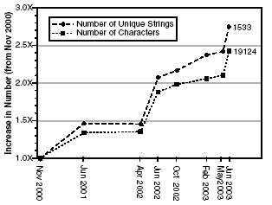
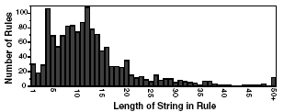
Snort
An Open Source Light Weight Intrusion Detection System
  Over 1500 rules extracted by network security experts.
  Software Based System
String Length Distribution
  From 1 byte to 121 bytes
# of Rules Growing Factor
  2.5 in 3 years

Slide 6
How Does Snort Do It?
Two Dimension Link List
Rule Tree Nodes (RTN)
  Header rules
Option Tree Nodes (OTN)
  Signatures
String Matching Algorithm
  Boyer-Moore, Aho-Corasick SFK, Wu-Manber etc.
Performance
  30%~80% CPU time on string matching only
  Offline Inspection
  Selective Online Inspection
RTN
RTN
RTN
OTN
OTN
OTN

Slide 7
Multi Pattern String Matching
Searching the text streams for a set of strings.
Precise Matching
  Aho-Corasick
  Commentz-Walter
  Wu-Manber
Imprecise Matching (with false positive)
  Parallel Bloom Filter
  Exclusion-based String Matching
Approximate Matching
  Tolerant some errors: character substituting, deleting or inserting

Slide 8
Boyer-Moore Algorithm
The Best Single Pattern Matching Algorithm
Bad Character Heuristics
  0 1 2 3 4 5 6 7 8 9...
  Text a b b a x a b a c b a
  b x b a c
  b x b a c
Good Suffix Heuristics
  0 1 2 3 4 5 6 7 8 9...
  Text a b a a b a b a c b a
  c a b a b
  c a b a b
  c a b a b
Both can be preprocessed and lookup tables are built
O(mn) time complexity
O(n/m) best performance
Both Heuristics can be used in multi-pattern matching algorithms
  Use with caution. May affect the network security!

Slide 9
SFK Search Algorithm
Compact Memroy Usage – Binary Trie
A Bad Character Table for fast shift
When match fails, back track the pointer to the starting match point
Worst case m*n memory reference
In Snort, may need traverse 20 trie nodes per character.
h
0
!h
1
3
e
!e
s
2
7
4
r
i
h
10
8
5
s
s
e
11
9
6

Slide 10
Wu-Manber Algorithm
Shift Table using Bad Character Heuristics, but for a block of characters.
Using Hash Table when shift fails
All strings have same length
Good for average case
te
3
at
0
at
cat
ic
2
ar
0
ar
bar
car
ba
1
oo
0
oo
foo
or
0
or
for
Shift Table
Hash Table
Member Set {
cat, car, bar, foo, for
}

Slide 11
Aho-Corasick Algorithm
Pattern Tree State Machine
  Goto Function
    Black Arrow
  Failure Function
    Blue Arrow
  Output Function
    Red Dot
O(n) search time
High fanout (256), low memory efficiency.
h
0
s
1
3
e
i
h
2
6
4
r
s
e
8
7
5
s
9
String set{
he, she, his, hers
}

Slide 12
Aho-Corasick Data Structure Optimization
Precompute the next state for every character form every state in the FSM.
  struct aho_state{
  struct aho_state * next_state[256];
  struct rule * rule_list;
  };
One memory reference per each character
Unoptimized data structure needs two memory references per character (via amortized analysis)
Unoptimized data structure can be optimized for space efficiency.

Slide 13
IP Lookup vs. String Matching
Both can be abstracted as longest prefix matching (LPM) problems
Both have tire based solutions
  IP Lookup
    Multi Bit Trie
    Lulea Algorithm – Leaf Pushing
    Eatherton Algorithm – Tree Bitmaps
  Multi Pattern String Matching
    Aho-Corasick
    SFK Search
Idea: Applying IP lookup techniques to string matching
  Modified Aho-Corasick Algorithm with memory efficiency

Slide 14
Unibit Trie for IP Lookup
Worst case lookup time is proportional to the length of IP address
a
1
0
0
1
1
b
d
1
0
0
Prefix | Next hop
* | a
00* | b
010* | c
11* | d
111* | e
11010* | f
c
e
1
0
f

Slide 15
Multibit Trie
Walk n bits a time
Accelerate the lookup time by a factor of n
Memory inefficiency
a
1
0
0
1
1
b
d
n1
1
0
0
c
e
n2
n4
1
0
f
n3

Slide 16
Tree Bitmap
Prefixes in same node stored in consecutive memory locations from top to bottom, from left to right, indexed by internal bitmap
Child nodes of same node stored in consecutive memory locations from left to right, indexed by expending path bitmap
a
0
1
0
1
1
b
d
n1
0
1
0
c
e
n2
n4
1
0
f
n3
Root Node n1
Internal Bitmap: 1 0 0 1 0 0 1
Expanding Path Bitmap 0 0 1 0 0 0 1 1
Next Hop Pointer -> a
Child Node Pointer -> n2

Slide 17
Optimizations for Aho-Corasick Algorithm (1)
Bitmap Compression
Benefit: 1028 Bytes/Node -> 44 Bytes/Node
Cost1: unoptimized data structure, 2 memory references per character in worst case
Cost2: popcount up to 256 prior bits in bitmap
h
0
s
0
1
3
e
i
h
Fail ptr
Rule ptr = Null
2
6
4
Next ptr
00000001000000000010000000
r
s
e
8
7
5
s
1
3
9

Slide 18
Optimizations for Aho-Corasick Algorithm (2)
Path Compression
Benefit1: decrease the total space (4:1 compression ratio)
Benefit2: decrease the number of memory references
Cost1: complex data structure, failure pointer may point to the middle of other path compressed node.
Cost2: software implementation penalty by too many unpredictable, data dependent branches.
h
0
s
1
3
e
i
h
fpt1
fpt2
fpt3
2
6
4
r
s
e
Next ptr=null
r
s
8
7
5
rpt1
null
rpt3
s
9
he
hers

Slide 19
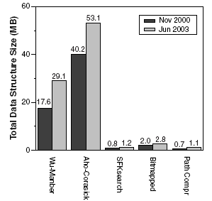
Data Structure Size for Snort Rule Set
20 times saving over Wu-Manber
50 times saving over Aho-Corasick
Similar as SFKSearch
# of rules increase 2.5x, while data structure size goes up by only 30%.

Slide 20
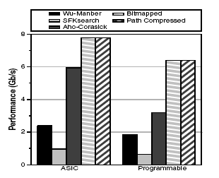
Intrusion Detection in Hardware
Accessible memory width of 128 bytes
  Has to be on-chip
Worst Case
  20 nodes/character in SFK Search
  80 rules/character for Wu-Manber
  1 or 2 nodes/character in Aho-Corasick
Performance
  2 times of Naïve Aho-Corasick
  8 times of SFK Search
  3.25 times of Wu-Manber

Slide 21
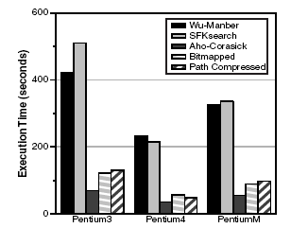
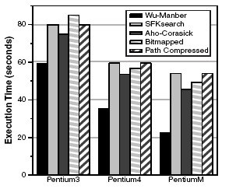
Intrusion Detection in Software
1GHz
2.5GHz
1.3GHz
Average Case
Real packet trace
Worst Case
Synthetic packet trace

Slide 22
Conclusions
A good review of the multi pattern string matching algorithms
Borrowing the tree-bitmap idea to effectively compress the data structure and improve the memory efficiency of Aho-Corasick algorithm
Deterministic time complexity is good for the security of the IDS itself.
Evaluate both hardware and software implementation. The promising solution lies in hardware.

Slide 23

Question & Discussion

